Slide 1
Hysteranthy Hysteria
Dan Buonaiuto

Slide 2
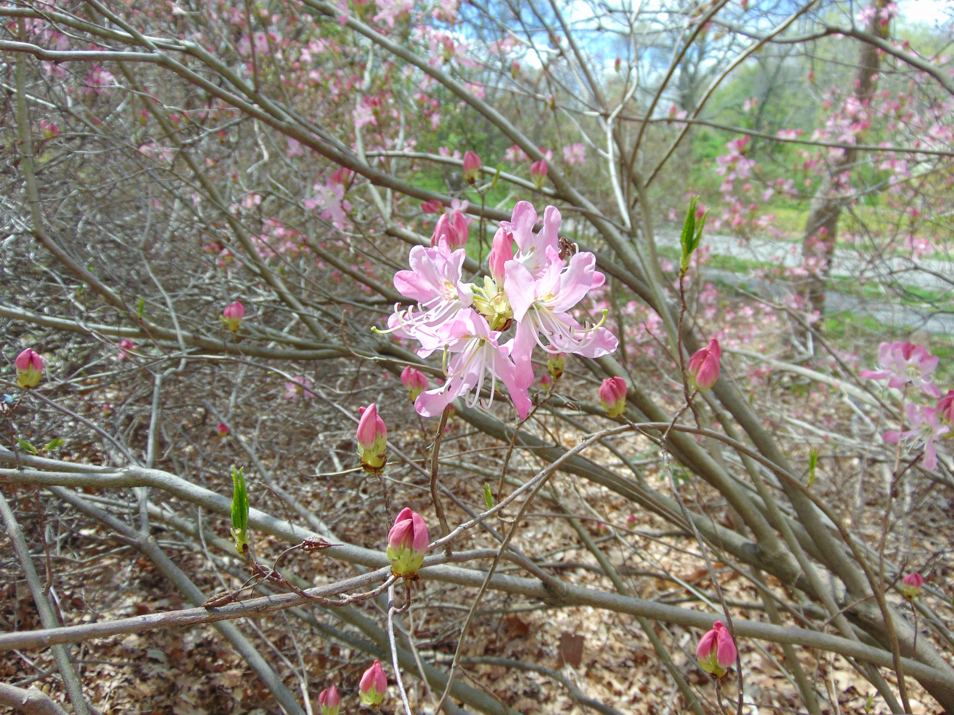
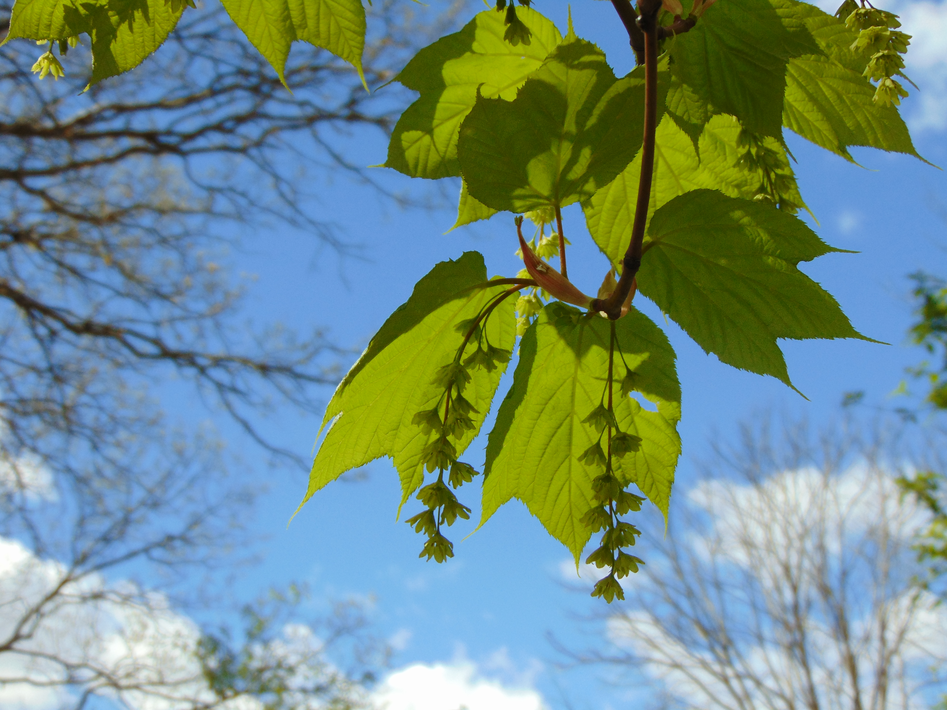
Why do some species flower before leafout, while others leafout before flowering?
To what degree are these patterns stable, especially in a changing climate space?
If patterns are flexible, what are the implications for tree reproduction and demography?

Slide 3
Hypothesizes
Wind pollination efficiency
May affect on male or female fitness, or both
Insect visibility
Differential selection pressures on foliar vs. floral phenology

Slide 4
Wind pollination efficiency

Slide 5
Wind pollination efficiency II

Slide 6

Insect visibility

Slide 7
Differential selection

Slide 8

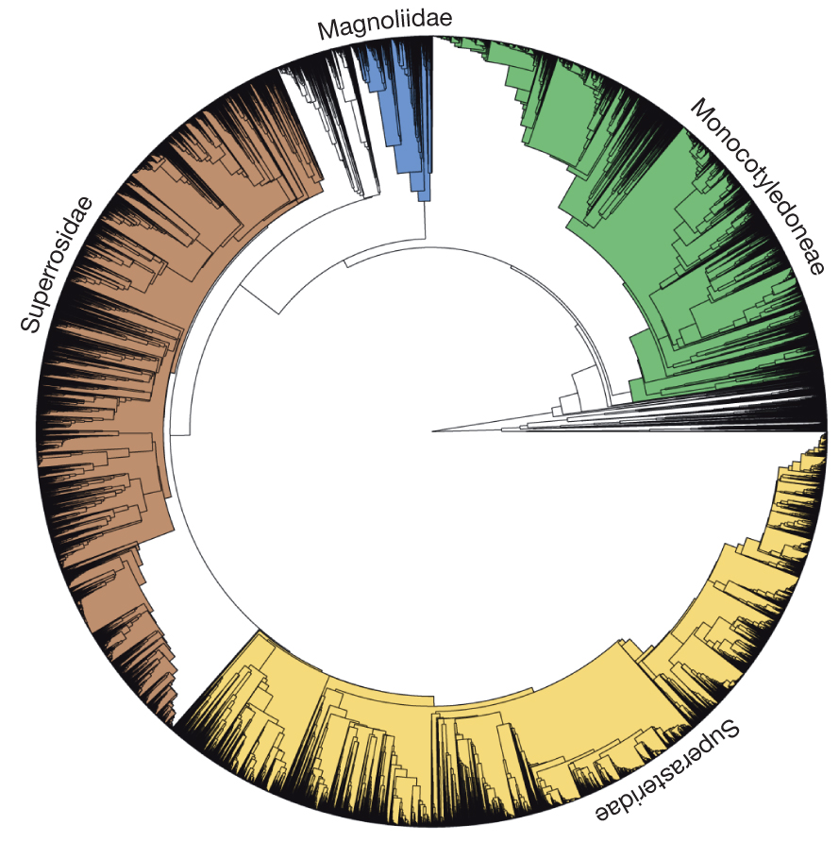

Data:
Phylogenetic Tree:
From: AE Zanne et al. Nature 000, 1-4 (2013) doi:10.1038/nature12872

Slide 11

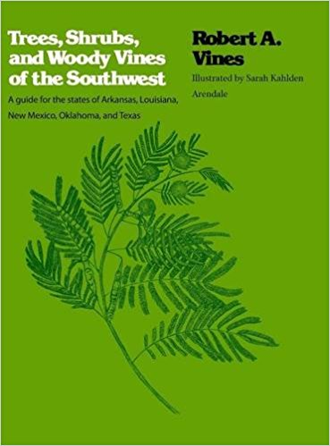
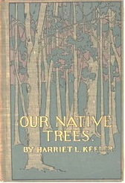
Model validation, inference space
USFS Silvics Manual:
Non-parallel data
Missing predictors
N~50, few df
In progress:
Non-parallel data
Missing predictors
N~100+ , model convergence more likely
Published 1900!
Non-parallel data
Missing predictors
N~50, few df

Slide 12
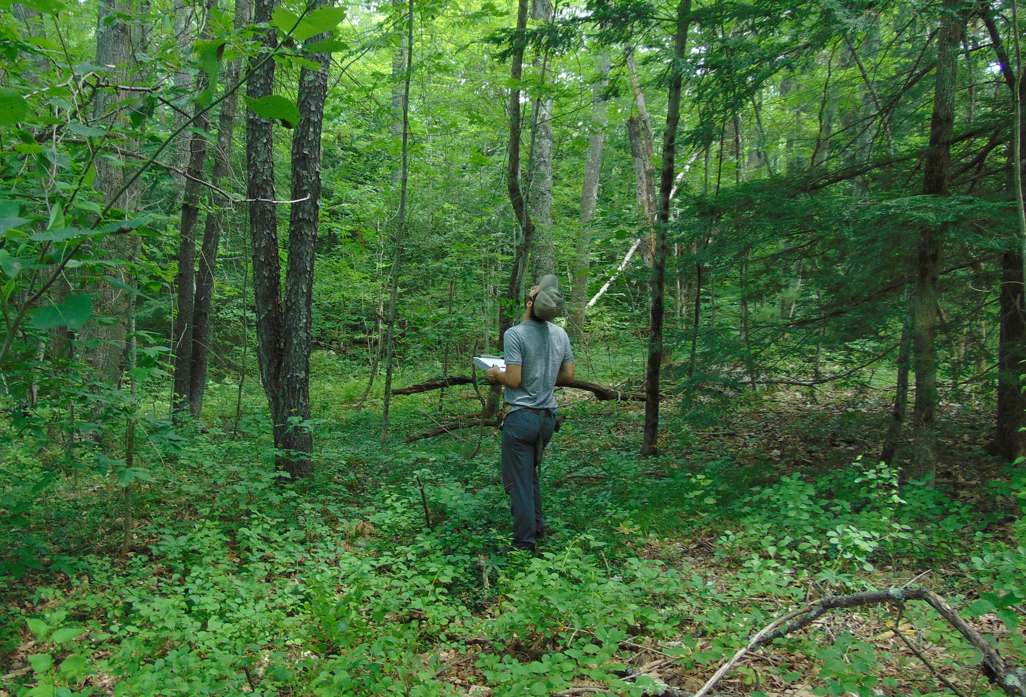
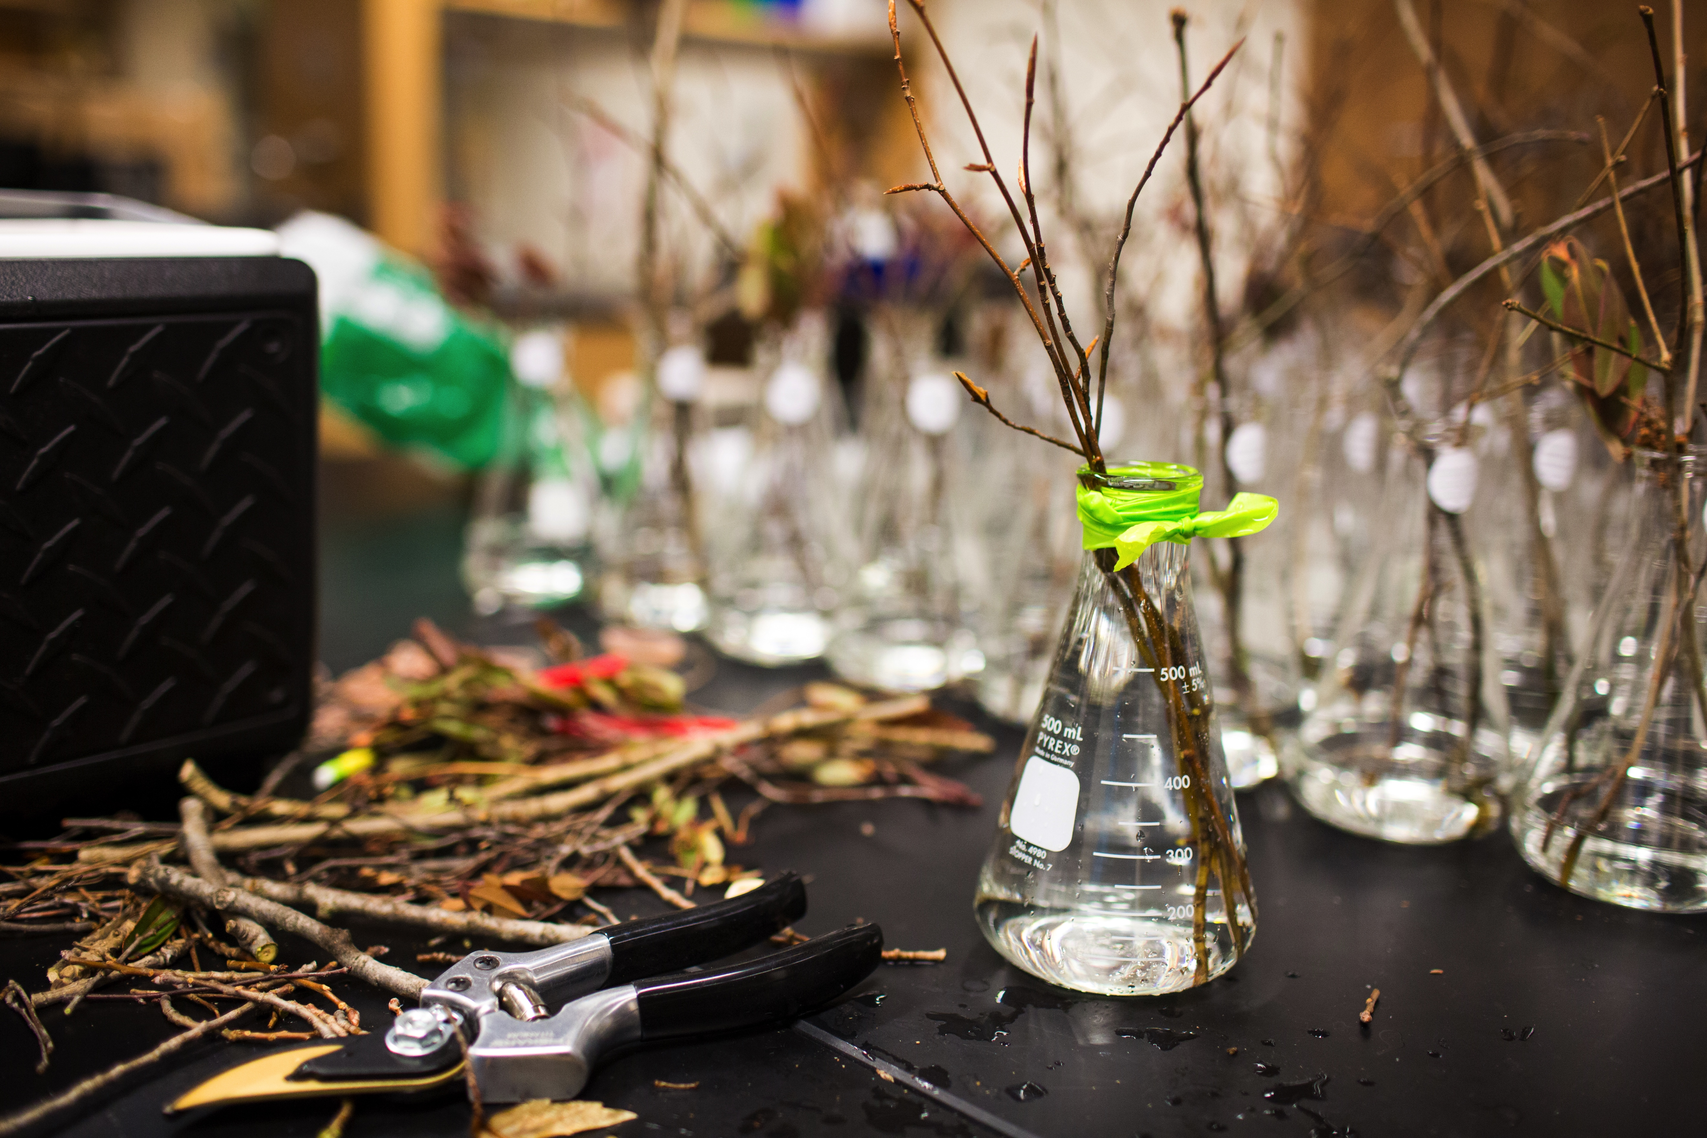
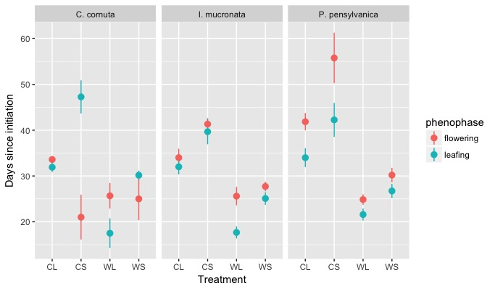
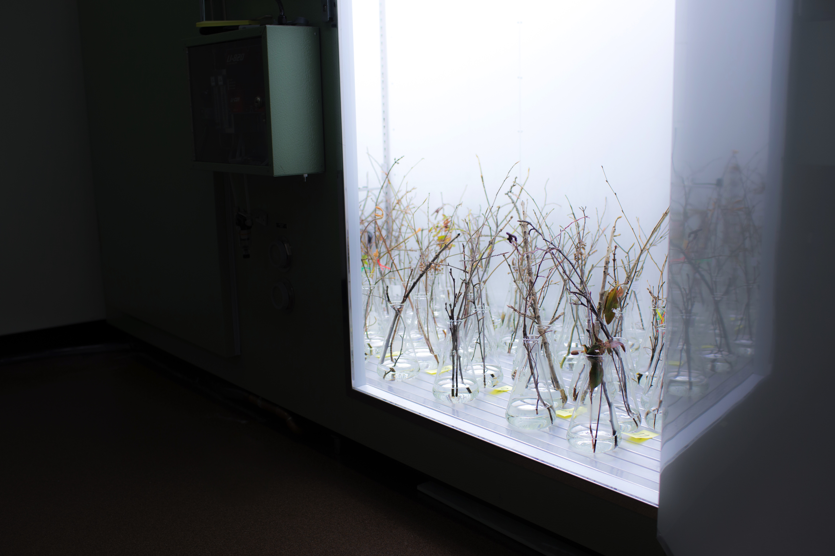
Part II: To what degree are these patterns stable, especially in a changing climate space?
Notes:
Do flowering and leafing phenologies exhibit similar sensitive to the same environmental cues? If not, we’d expect to see changes to the the interphase duration or phenological sequence under different conditions.

Slide 13
Possible patterns
Field
1.
2.
3.

Slide 14
3.
2.
1.

